Slide 1

The Climate Quiz
Notes:
Tip: for the bonus questions, print and cut out the categories before you start the quiz.

Slide 2
Objectives
Have fun
Test your knowledge
Learn more
Maybe - win a prize!

Slide 3
First: Pick your team (2 teams)

Slide 4
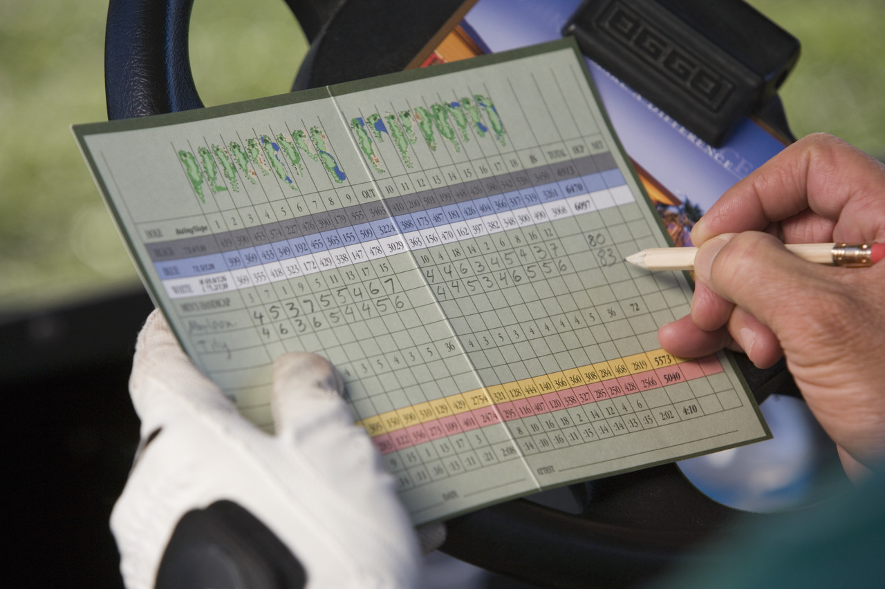
Now we need a score keeper…

Slide 5
Rules
First team gets a question
Team has 1 minute (max) to answer
If it is answered correctly, the team gets a point
If the team answers incorrectly or it takes too long, the other team gets the opportunity to answer
The team with the most points wins!
Notes:
Tip: ask the whole team to discuss and agree and pick a different person each time to answer.

Slide 6
Let's play!

Slide 7
1. Why is the planet warming up?
The sun is getting closer & hotter as part of a natural sun cycle
Heat-trapping gases are building up in the atmosphere, preventing warmth from the sun escaping back out into space
Scientists do not know why the earth is warming up, they just know that it is

Slide 8
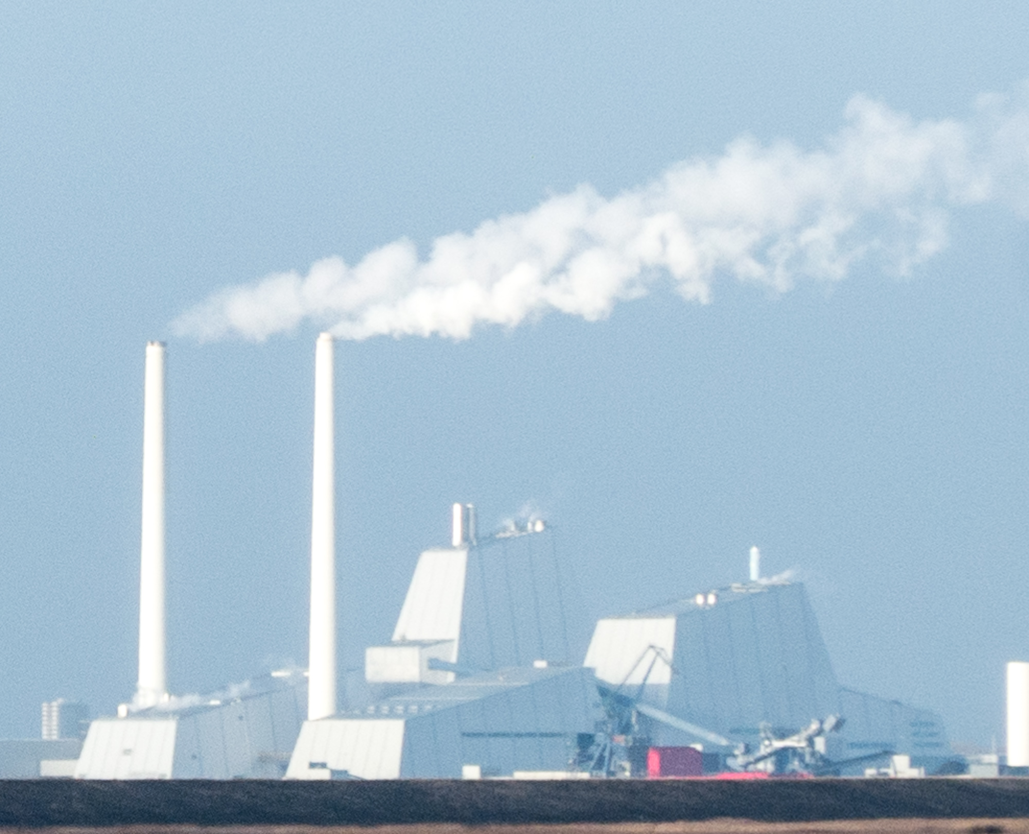
1. Why is the planet warming up?
B. Heat-trapping gases are building up in the atmosphere,
preventing warmth from the sun escaping back out into space
Humans release heat-trapping gases into the atmosphere
But they prevent heat from escaping back out.
These heat-trapping gases let sunlight in.

Slide 9
2. What is this process called?
Global dimming
Air pollution build-up
The greenhouse effect
Atmospheric thickening

Slide 10
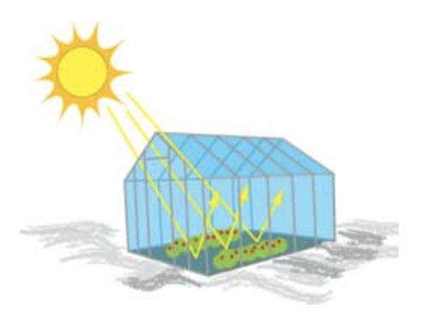
2. What is this process called?
Notes:
Image: https://spaceplace.nasa.gov/greenhouse/en/
Explanation: A greenhouse traps the sun’s energy inside

Slide 11
3. What evidence of climate change have scientists already observed?
The planet is warmer on average
The sea level is rising
El Niño happened in 2015-2016
Answer A and B
All of the above

Slide 12

3. What evidence of climate change have scientists already observed?
The planet is warmer on average by 0.87ºC (2006-15 compared to 1850-1900)
The sea level is rising by 1.8 mm/year since 1961, and 3.1 mm/year since 1993. The rate is increasing!
El Niño did happen, but this is not a result of climate change
Answer A and B
All of the above
Notes:
Source: IPCC AR5

Slide 13
4. What are the two biggest causes of this build up of heat-trapping gases in the atmosphere?
Industry and energy supply
Agriculture and forestry (including deforestation)
Burning of fossil fuels and land-use change
Transport and buildings

Slide 14
4. What are the two biggest causes of this build up of heat-trapping gases in the atmosphere?
Industry (21%) and energy supply (1.4%)
Agriculture and forestry (including deforestation) (24%)
Burning of fossil fuels and land-use change – encompasses all of these categories!
Transport (14%) and buildings (6.4%)
This was sort of a trick question ☺…
Notes:
IPCC AR5: https://www.ipcc.ch/site/assets/uploads/2018/02/SYR_AR5_FINAL_full.pdf

Slide 15

Bonus: Race for both teams -
a point for the team that finishes first!
Match the following terms with their correct definitions…
Notes:
IPCC AR5: https://www.ipcc.ch/site/assets/uploads/2018/02/SYR_AR5_FINAL_full.pdf

Slide 16
Match the term with the definition
Term
Definition
Weather
Climate
Climate change
Climate variability
Refers to average weather conditions over a long period of time (30+ years)
Refers to conditions like rain, temperature and wind over hours to days
Refers to the way climate fluctuates yearly above or below a long-term average value
Refers to a statistically significant change in the state of the climate (or average weather) that persists for an extended period of time (decades or longer)

Slide 17
Match the term with the definition
Term
Definition
Weather
Climate
Climate change
Climate variability
Refers to average weather conditions over a long period of time (30+ years)
Refers to conditions like rain, temperature and wind over hours to days
Refers to the way climate fluctuates yearly above or below a long-term average value
Refers to a statistically significant change in the state of the climate (or average weather) that persists for an extended period of time (decades or longer)
The difference is in the timescale!

Slide 18
5. If we stopped all greenhouse gas emissions today, would we still have climate change?
Yes
No

Slide 19
5. If we stopped all greenhouse gas emissions today, would we still have climate change?
Yes, humans have been adding greenhouse gases to the atmosphere for so many years now, that even if all emissions stopped today, the planet would still continue to warm for decades to come
No, the greenhouse gases in the atmosphere would quickly dissipate, immediately stopping the warming and related changes in the climate
Notes:
Answer: Yes
However, dramatically reducing our emissions is still critical in order to prevent run-away climate change and to keep climate risks manageable.

Slide 20
6. If we know the climate change projections for 2100, do we need to pay attention to forecasts on shorter timescales?
Yes
No

Slide 21
6. If we know the climate change projections for 2100, do we need to pay attention to forecasts on shorter timescales?
Yes, because between now and 2100 natural climate variability and weather could bring us conditions/events that are different from the long-term projections
No

Slide 22
7. If we experience an extreme weather event, can we attribute that particular event to climate change?
Yes, always
Yes, sometimes
No, never

Slide 23
7. If we experience an extreme weather event, can we attribute that particular event to climate change?
Yes, always
Yes, sometimes - Climate scientists used to say “we can’t attribute any single event to global warming”. The science is advancing fast: it is now often possible to estimate the extent to which human-induced climate change has influenced either the magnitude or the probability of occurrence of specific types of events
No, never
Notes:
Scientific attribution of climate change to specific events is yet most certain for:
Extreme heat and cold
followed by drought and extreme rainfall
.. and still most difficult for:
Tornadoes
followed by wildfires and cyclones

Slide 24
8. By what year will we pass the 1.5 degrees in warming limit according to current projections? (question date: 2018)
2100
2060
2040
Notes:
https://www.ipcc.ch/sr15/

Slide 25
8. By what year will we pass the 1.5 degrees in warming limit according to current projections? (question date: 2018)
2100
2060
2040
At current warming rate we will hit 1.5 degrees of warming by 2040. Even if we stopped emissions now the world would continue to warm due to the emissions already in the atmosphere, therefore we need to halve emissions within 11 years and get to net carbon zero by 2050 to stay within 1.5 limit.
Notes:
https://www.ipcc.ch/sr15/

Slide 26
Bonus: Race for both teams -
a point for the team that finishes first!
Match the following terms with their correct definitions…
Notes:
IPCC AR5: https://www.ipcc.ch/site/assets/uploads/2018/02/SYR_AR5_FINAL_full.pdf

Slide 27
Match the term with the definition
Term
Definition
Climate resilience
Climate change adaptation
Climate change mitigation
Action taken to reduce the amount of greenhouse gasses in the atmosphere
Action taken to reduce the impacts of climate change on lives, livelihoods and ecosystems
The ability of a system (household, community, farm, value chain, ecosystem) to anticipate, absorb, accommodate or recover from the effects of a climate shock or stress

Slide 28
Match the term with the definition
Term
Definition
Climate resilience
Climate change adaptation
Climate change mitigation
Action taken to reduce the amount of greenhouse gasses in the atmosphere
Action taken to reduce the impacts of climate change on lives, livelihoods and ecosystems
The ability of a system (household, community, farm, value chain, ecosystem) to anticipate, absorb, accommodate or recover from the effects of a climate shock or stress

Slide 29
Challenge Questions
These questions are not multiple choice
Each team has 1 minute to write down an answer
Correct answers earn 1 point each (max 5)

Slide 30

Challenge
Name five things scientists project for our future given climate change

Slide 31
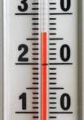

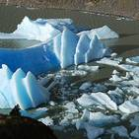
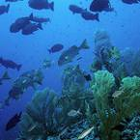
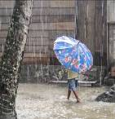
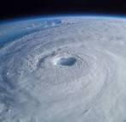
Possible answers
Rising temperatures, heat waves
Sea level rise
Scientists very sure
Melting ice
Ocean acidification
Changing rainfall patterns
Less clear,
and regional differences
Changes in extreme events
Notes:
Walk through an overview of the expected changes, using the points below. Explain that the rest of the presentation will cover impacts on human society in more detail.
It is a fact that Greenhouse Gas concentrations is increasing, but the effects following from that have different levels of “certainty”:
1) Rising temperatures – with heat waves:
We know that at the “global scale” (i.e. for most land areas with sufficient data)
It is very likely that there has been an overall DECREASE in the number of cold days and nights.
It is very likely that there’s been an overall INCREASE in the number of warm days and nights.
In the future, for most land areas, this trend is expected to continue.
Sea surface temperatures are also rising; “minimum” temperature extremes have risen.
Heat waves are expected to become more frequent and more intense.
Source: http://www.climatechange2013.org/images/uploads/WGIAR5_WGI-12Doc2b_FinalDraft_Chapter02.pdf
2) Sea level rise
-Ocean thermal expansion and glacier melting have been the dominant contributors to 20th century global mean sea level rise.
-Thermal expansion: ocean temperatures have been increasing, water expands as it warms → sea level rise
-Glacier melting: land based ice that melts and flows into the ocean, increasing mass of water in the ocean → sea level rise.
-Higher sea levels put coastal cities at risk from flooding, more intense storm surges, and coastal erosion.
-Higher sea levels also increase risks for salt-water contamination of farmland and freshwater sources.
Source: http://www.climatechange2013.org/images/uploads/WGIAR5_WGI-12Doc2b_FinalDraft_Chapter13.pdf; http://www.ipcc.ch/publications_and_data/ar4/wg1/en/faq-5-1.html
3) Melting ice (sea ice and glaciers)
Sea ice = frozen sea water that floats on the ocean’s surface
Glaciers = dense, year-round ice on land, examples: Greenland and Antarctic ice sheets, and mountain glaciers in Asia, Europe and the Americas
- Rising temperatures have caused glaciers and sea ice (especially around the North Pole) to melt faster than many scientific projections
- Melting ice has implications for sea level rise and ocean chemistry.
Source: http://www.climatechange2013.org/images/uploads/WGIAR5_WGI-12Doc2b_FinalDraft_Chapter13.pdf
4) Ocean acidification – and its effects
-The ocean has absorbed more CO2 as emissions have risen, this increases the pH of the water and has serious implications for marine life, e.g. when the sea turns more acidic (with CO2) the calcium 'skeletons' of many lifeforms cannot be formed (or are weakened). Biodiversity is under pressure due to increasingly inhospitable environmental conditions (e.g., coral bleaching because of acidifying oceans).
Source: http://www.climatechange2013.org/images/uploads/WGIAR5_WGI-12Doc2b_FinalDraft_Chapter03.pdf
5) Changing rainfall patterns
Data limitations make it difficult to say with certainty what the rainfall trends will be in all regions of the globe, BUT:
on average, places that have currently have heavy precipitation can expect to see the intensity of rainfall events increase, places that are dry can expect less frequent rainfall (but more intense rain when it falls). And even in areas that on average may expect decreasing total rainfall, the rains may fall in shorter, intense bursts.
Or in other words: “The wet get wetter and the dry get drier”; this means drought and flash floods becomes more frequent in many places around the world.
Sources: http://www.gfdl.noaa.gov/cms-filesystem-action/user_files/kd/pdf/gfdlhighlight_vol1n5.pdf; http://www.ipcc.ch/news_and_events/docs/ar5/ar5_wg1_headlines.pdf
6) Changes in extreme events
-Heat waves and droughts have become more frequent, and in some places, more intense.
-It is difficult to measure the frequency and intensity of floods, but generally there has been an increasing trend.
-Climate change is expected in increase the frequency of high-intensity tropical storms.
-Very difficult to identify trends with tornados, dust storms, hail, and other severe local events because data reliability is low and current climate models don’t simulate these phenomenon. BUT, risks are expected to increase with demographic and land use changes increase people’s exposure to these events.
Sources: (http://ipcc-wg2.gov/SREX/images/uploads/SREX-SPMbrochure_FINAL.pdf) (http://www.nature.com/nclimate/journal/v2/n3/full/nclimate1357.html) (http://www.ipcc.ch/publications_and_data/ar4/wg1/en/ch3s3-8-4-2.html) (http://www.ipcc.ch/pdf/special-reports/srex/SREX_Full_Report.pdf)
(explain that this presentation will go through these points in more detail)
“Melting ice” picture: http://www.flickr.com/photos/worldresourcesinstitute/3525024219/ ; Photo by Linda Shaffer, World Resources Institute, 2009.
“Ocean acidification” picture (bleached coral): http://www.flickr.com/photos/worldresourcesinstitute/5476510553/ ; Photo by Mark Spalding, World Resources Institute, 2011.
"Extreme events" picture: NOAA
Remaining pictures: Climate Centre
31

Slide 32
Challenge
What kind of humanitarian impacts could this have? (max 5)

Slide 33
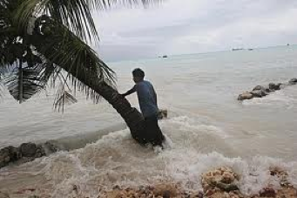
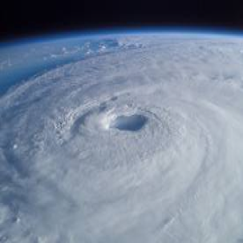
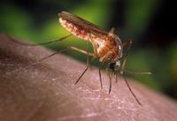
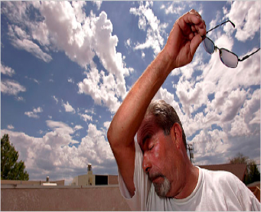
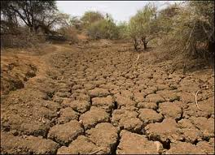
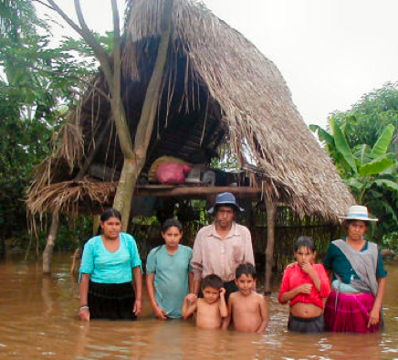
Let’s hear from each team, one point for every impact listed.
Impacts listed that the facilitator finds questionable or do not have a logical justification will be tabled for further research (no points).
Notes:
Note that for health, malaria, malnutrition, respiratory diseases and diarrhoea are all linked to climate change.
Increasing heat and extreme events are impacting health by affecting air quality, changing disease patterns, affecting water quality and availability and food security.

Slide 34
Let’s tally the points…

Slide 35

Congratulations!!
Winning team, you get a prize!
Losing team, we hope you had fun while learning ☺ Maybe the winning team will share their prize with you…

